Slide 1
DMIT 1530
Week 3
Floats

Slide 2
Floats are based upon this
old thing called ‘print layouts’.

Slide 3
Most text elements are block-level elements, which means they will normally occupy their own row.

Slide 4
But what if we want to have something that looks like a text wrap (text beside another element)?
Normally, text does not flow beside other elements.

Slide 5
This is where floats come in.
Floats yank things out of the regular document flow and let that thing ‘float’ on either the left or right side of its container.

Slide 6
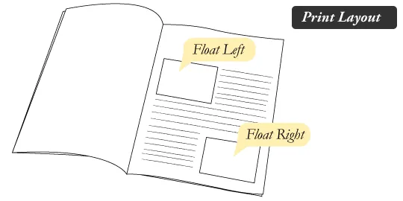
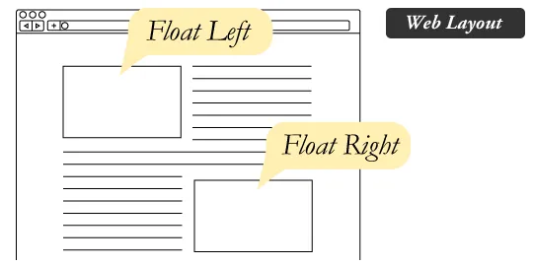

Slide 7
p { float: left; }
/* This will make all paragraphs float to the left side of
their container. */

Slide 8
Okay, but if things are taken out of the normal document flow, what about everything that comes after it? How do you get your page to stop floating?

Slide 9
In order to do that, you need to clear your floats.

Slide 10
footer { clear: both; }
/* This moves the footer below any floating elements (returns it to the normal document flow). */

Slide 11
In fact, many reset codes include something called a clearfix.
A clearfix is a hack that you apply to a container with floating things inside of it. It says “after this element, go back to the normal document flow”.

Slide 12
Floats were never intended to be for full page layouts. This is why we now use other solutions,
like flexbox and grid.

Slide 13
However, because they were used for layouts for so many years, you may come across them in the wild.

Slide 14
References
CSS Tricks: All About Floats
https://css-tricks.com/all-about-floats
MDN: float
https://developer.mozilla.org/en-US/docs/Web/CSS/float

